Slide 1

Introduction
Lecture 0.1 | CSE421 – Computer Networks
Department of Computer Science and Engineering School of Data & Science

Slide 2
Objectives
Internet today
Network in our lives
Course outline
Online Learning
Marks Distribution
Books
About CCNA

Slide 3
Internet Applications (2020)
Internet Users
4.48B users worldwide
2.1B in Asia
Web
1.94B – Number of websites (December).
200+ m – Added websites in 2019
Email
3.9B people used email
Facebook
2.45 B users in 2019 December
3.2 billion reacts on Facebook every day.
Other Social Media
321+ m users in Twitter
500 million of tweets sent every day

Slide 4
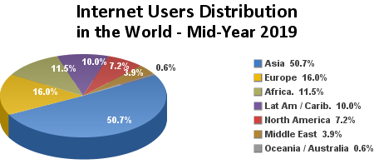

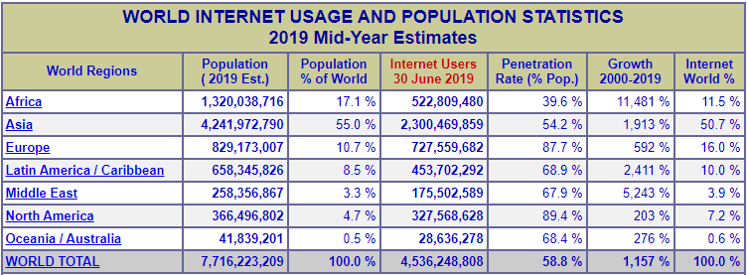
Internet Statistics (2019)

Slide 5
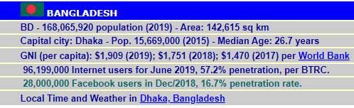
Internet Statistics (2019) - Bangladesh
Source; http://www.internetworldstats.com/

Slide 6
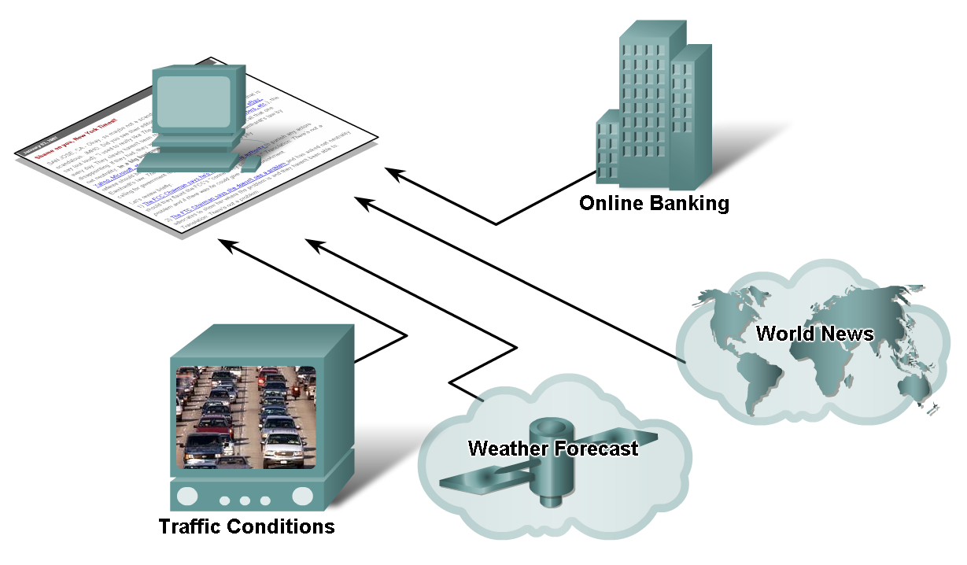
Networks supporting the way we live

Slide 7
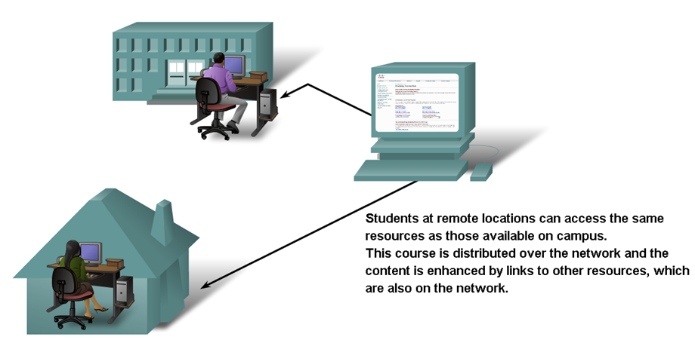
Networks supporting the way we learn

Slide 8
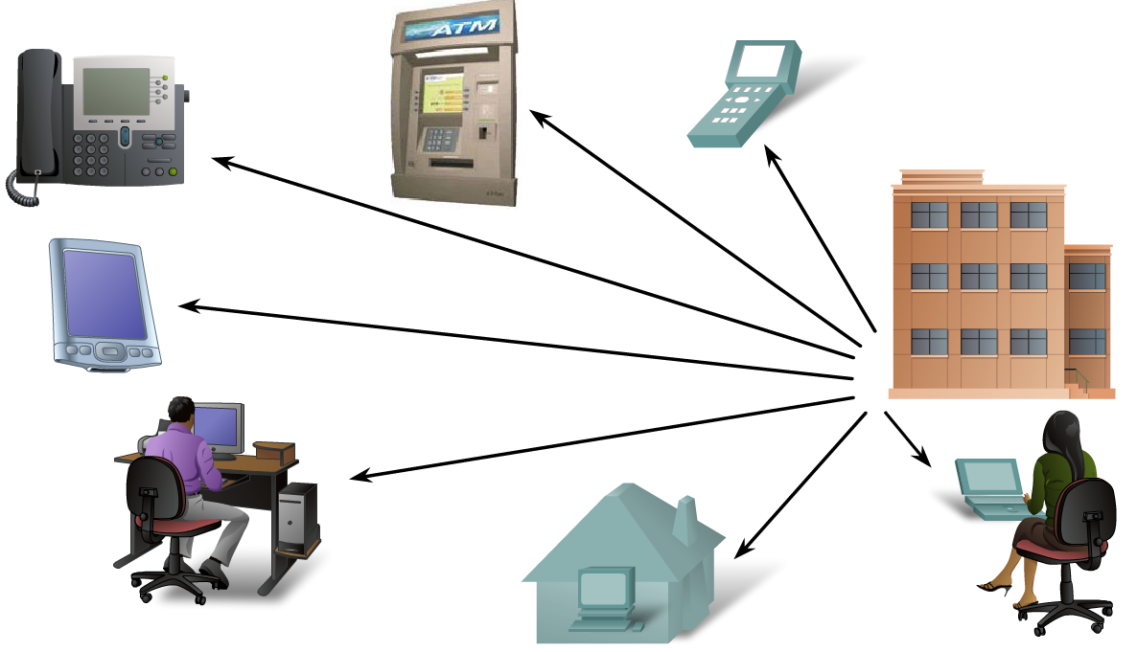
Networks supporting the way we work

Slide 9
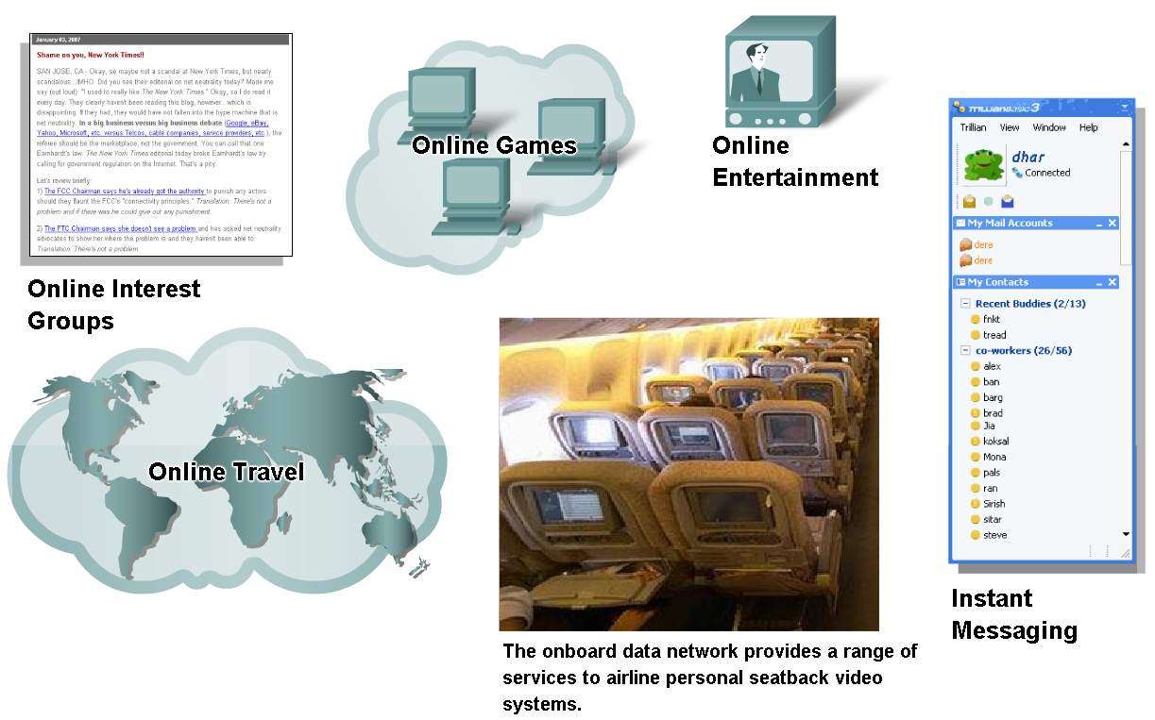
Networks supporting the way we play

Slide 10
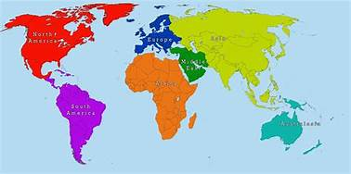



How?

Slide 11
Course Outline
Protocols and Network Architecture
Introduce the concepts of network architectures, topologies, layering and protocols.
Application Layer
Describe key application layer concepts such as network services required by applications, clients and servers.
Transport Layer
Explain transport layer concepts, relationship with the network and application layers, and services such as principles of reliable data transfer and congestion.
Network Layer
Teach network layer concepts, routing principles, algorithms, and addressing and Internet’s various protocols.

Slide 12
Course Outline
Data Link Layer
Identify link layer services, link layer address and multi-access techniques.
Network Security
Teach basic knowledge of the use of cryptography and network security.
Wireless Networks
Explain the operation of wireless LANs based on the IEEE802.11 standards, and mobility.
Labs
Using simulation tools to observe and analyze behaviors of networking protocols.
Outcome
Design and create a small network for an organization.

Slide 13
Online Learning
Video Lectures
Uploaded before class
Live Class Sessions
For clarifications. Question and answer sessions
Quizzes
6~8 quizzes (Best N-2 at max will be taken)
Assignments
6 to 8 assignments
**Quizzes and Assignments are section based.
** Grading policy according to the University.

Slide 14
Tentative Marks Distribution
Category | Distribution
Assignments | 4%
Moral Assessment | 2%
Quizzes | 15%
Midterm | 24%
Labs | 15%
Finals | 35%
Attendance | 5%

Slide 15
Books
Title | Author | Edition | Year | Publisher | ISBN
Computer Networking: A Top-Down Approach Featuring the Internet | Jim Kurose and Keith Ross | 7th | 2017 | Pearson | ISBN-13: 978-0133594140
Data Communication and Networking | Behrouz Fourazan | 5th | 2017 | Mac-Graw Hill | ISBN-13: 9780073376226
CCNA 200-301 Official Cert Guide, Volume 1 | Wendell Odom |  | 2019 | Cisco Press | ISBN-13: 978-0-13-579273-5

Slide 16
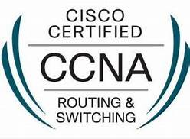

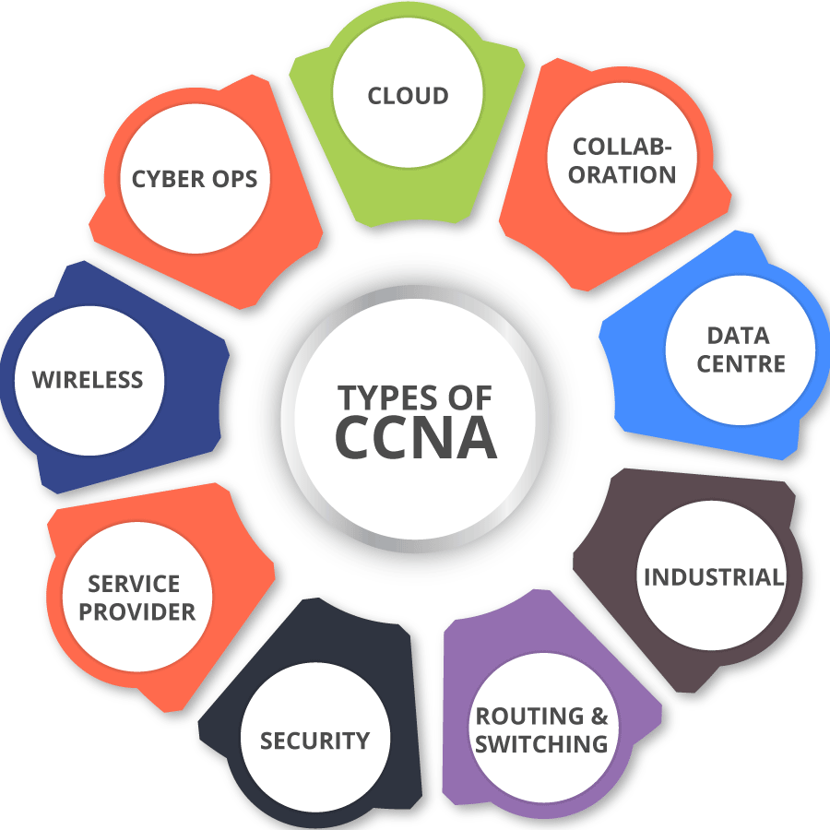
CCNA
Cisco Certified Network Associate (CCNA)
A popular industry certification program in computer networking developed by Cisco Systems.
Cisco created the CCNA to recognize basic competency in the installation and support of medium-sized networks.
Globally recognized and it is respected by most companies across the globe.
This certificate, not only enhances the career growth opportunities, but also provide the candidates with a higher pay scale.

Slide 17
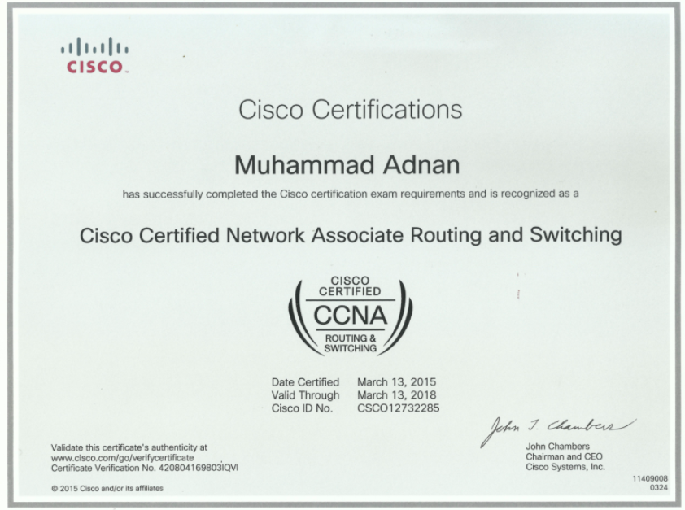
CCNA Certification
Eligibility Criteria
To receive the CCNA certificate an individual must have passed either of two exams:
1. ICND1 Exam (100-105) and the ICND2 (200-105)
(Cost $150 each) (90 mins each)
2. Combined CCNA Exam (200-301) (Cost $300) (120 mins)
Cisco Networking Academy students get discount vouchers.
Validity 3 years
Exam must be given at a Pearson VUE center

Slide 18
CCNA Content
CCNA Module | Name of Module | Aligned with which Bracu Courses
CCNA 1 v7 | Introduction to Networks | CSE421
CCNA2 v7 | Routing, Switching & Wireless Essentials | CSE490 (WAN Routing)
CCNA3 v7 | Enterprise Networking, Security & Automation | CSE490 (WAN Routing)
**We do not provide the “Vendor Certification”
** We do provide a certification of course completion.

Slide 19
For Queries be present in the live sessions. Or post your queries in the discussion board
Thank you

